Slide 1
Data Visualizations

Slide 2
Why do we need visualizations?

Slide 3
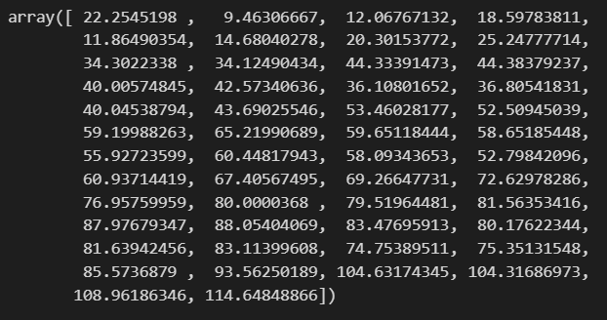
Before

Slide 4
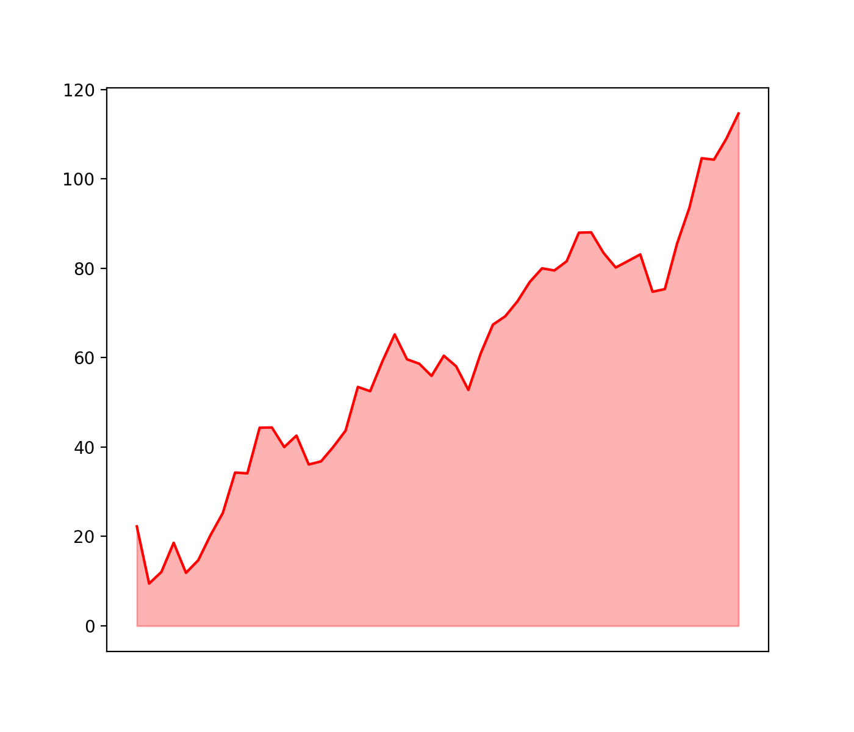
After

Slide 5
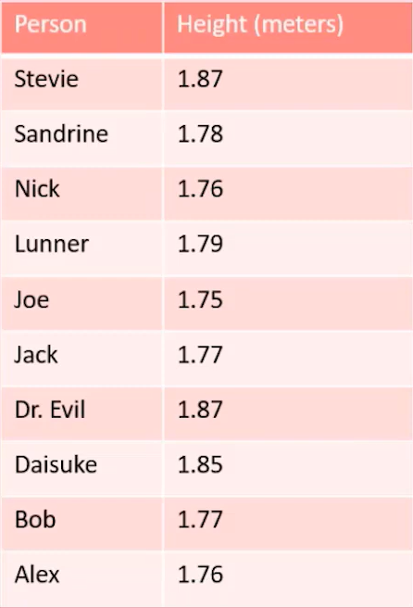

Slide 6
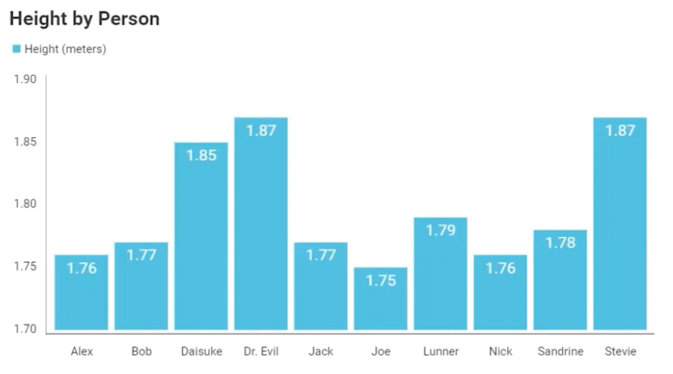

Slide 7
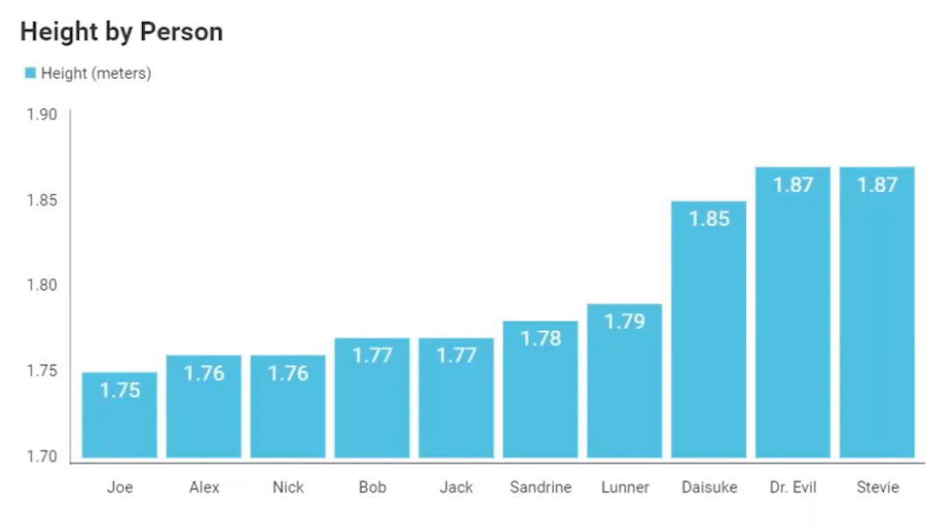

Slide 8
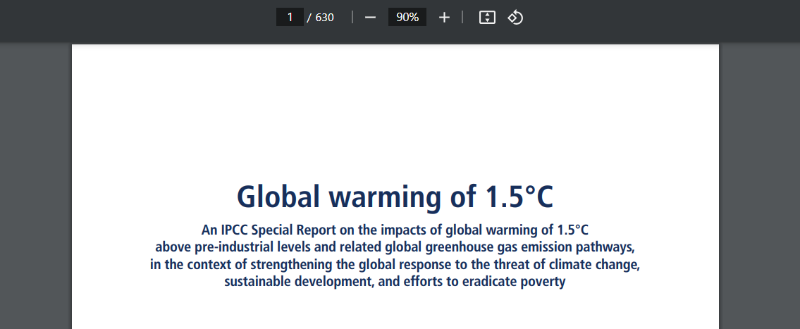

Slide 9



Slide 10
Main libraries

Slide 11
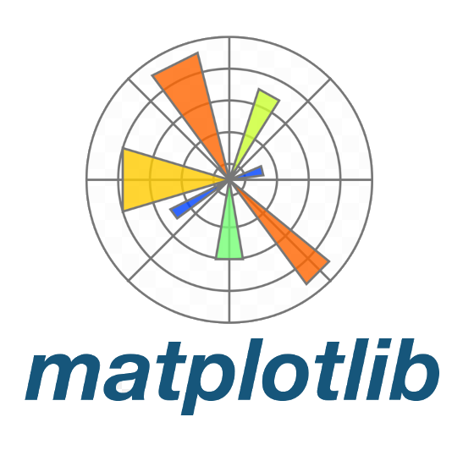
Main libraries
Fundamental

Slide 12

Main libraries
Fundamental

Slide 13

Main libraries
Fundamental
Interactive

Slide 14
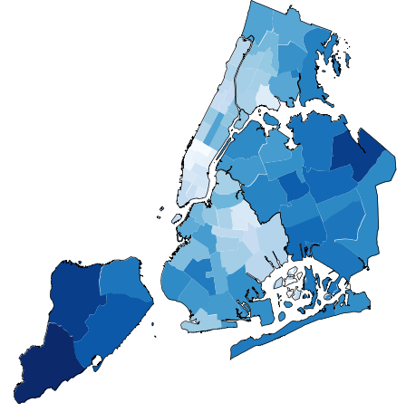
Main libraries
Fundamental
Interactive
Geospatial
Geoplot

Slide 15

Main libraries
Fundamental
Interactive
Geospatial
Geoplot

Slide 16
Other visualization apps

Slide 17



Other visualization apps

Slide 18
How to visualize data distribution

Slide 19
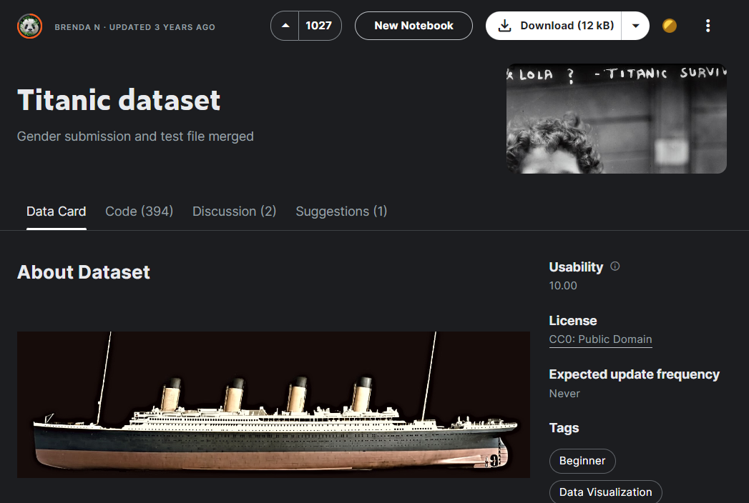

Slide 20
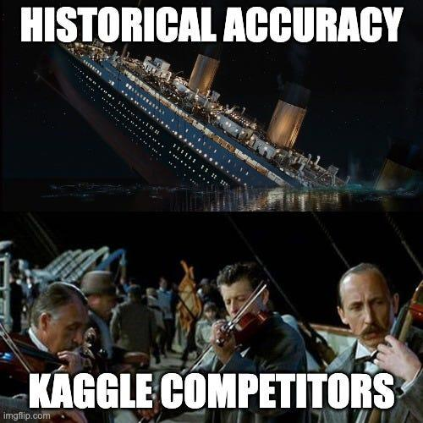

Slide 21
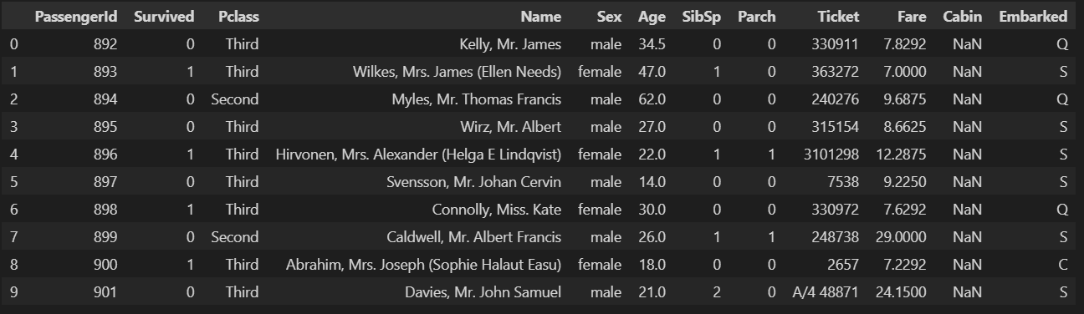

Slide 22
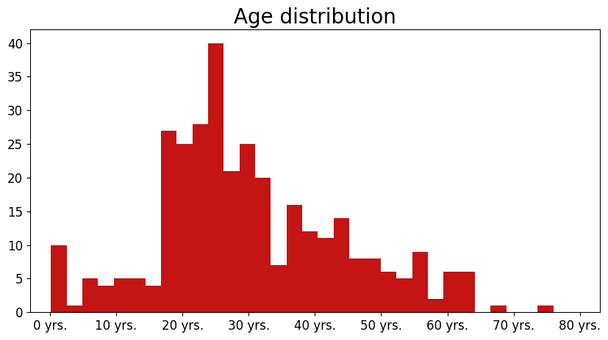
Histogram

Slide 23
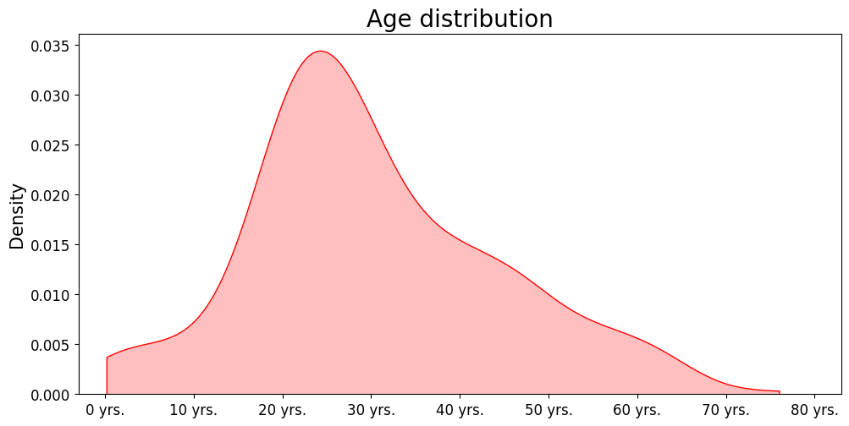
Density plot

Slide 24
KDE

Slide 25
KDE - Kernel Density Estimator

Slide 26

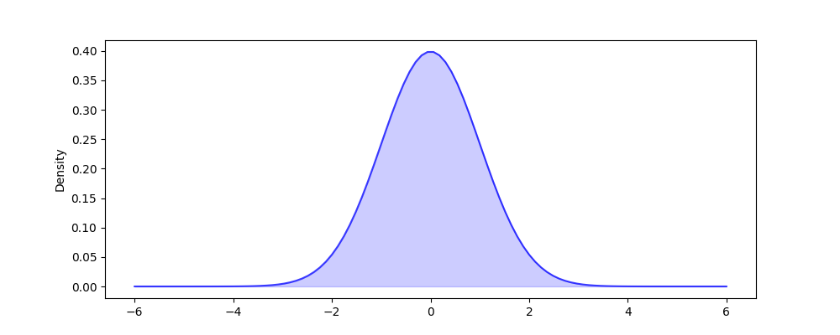
Density plot

Slide 27
Density plot

Slide 28

Density plot

Slide 29
Density plot
h - kernel bandwidth

Slide 30

Density plot
h - kernel bandwidth

Slide 31
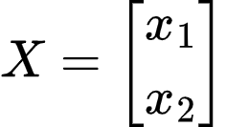
Density plot

Slide 32

Density plot

Slide 33
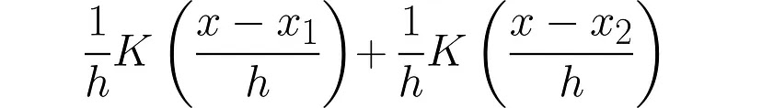
Density plot

Slide 34
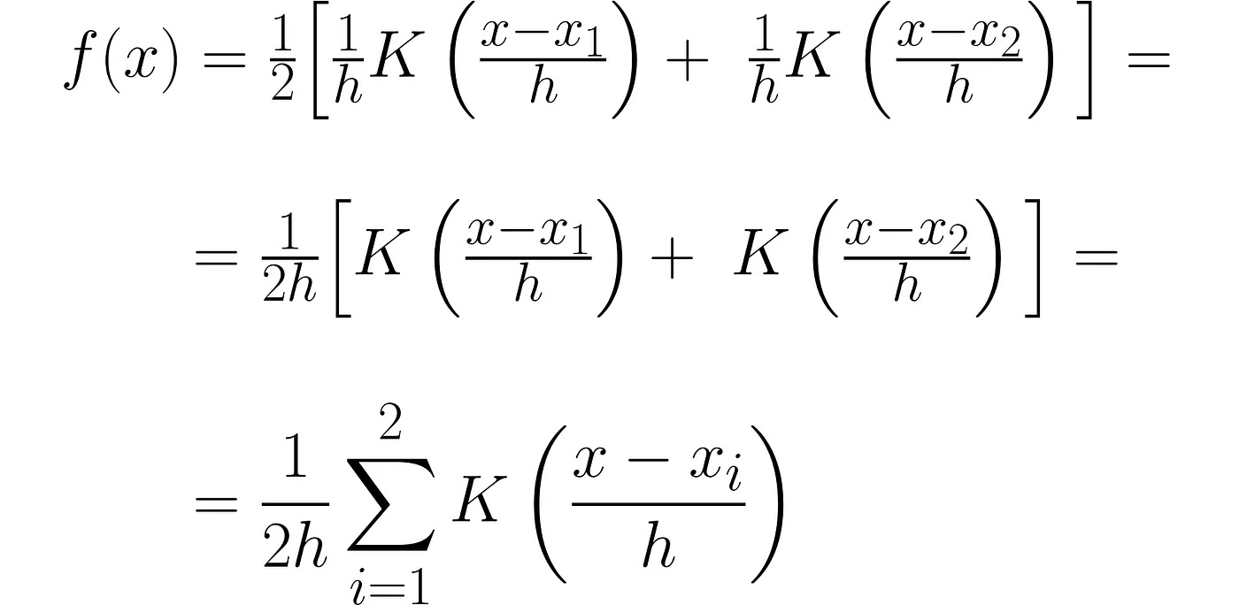
Density plot

Slide 35
Density plot

Slide 36
Density plot

Slide 37
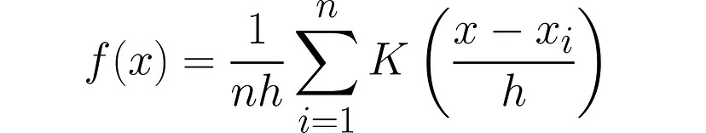
Density plot

Slide 38
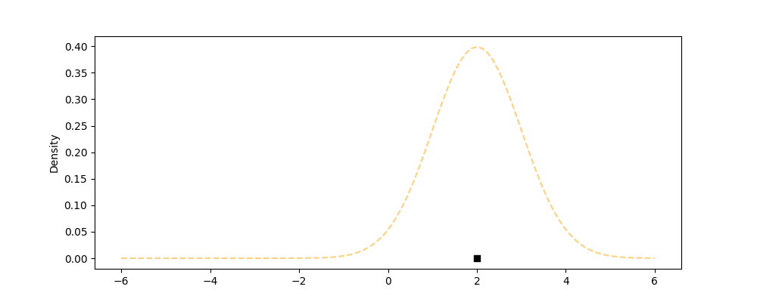
Density plot

Slide 39
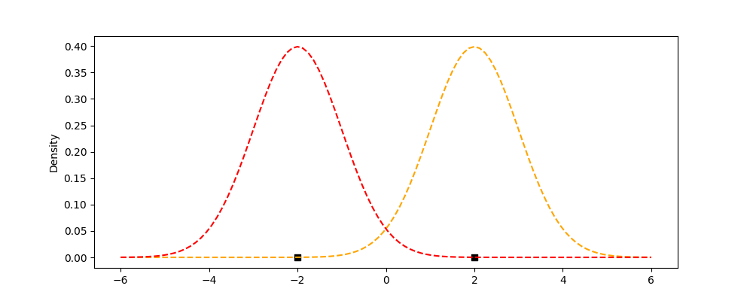
Density plot

Slide 40
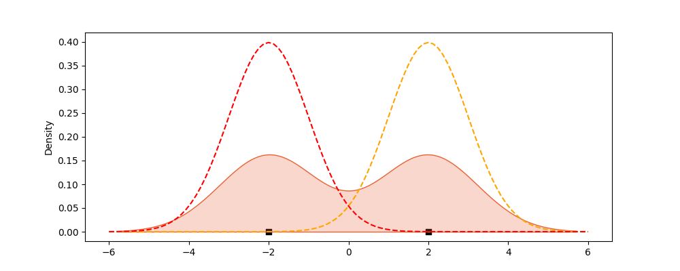
Density plot

Slide 41
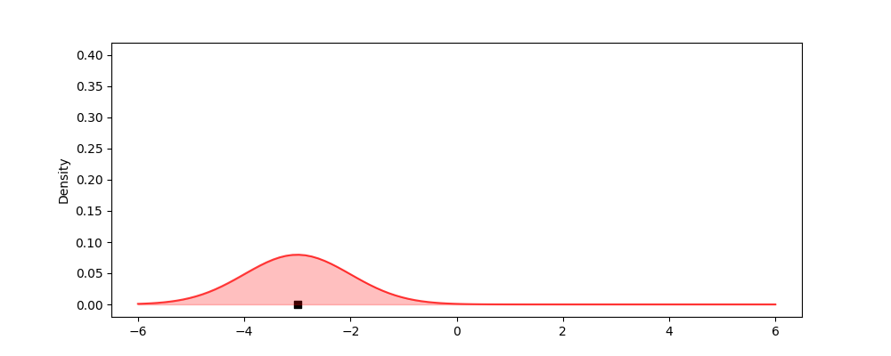
Density plot

Slide 42
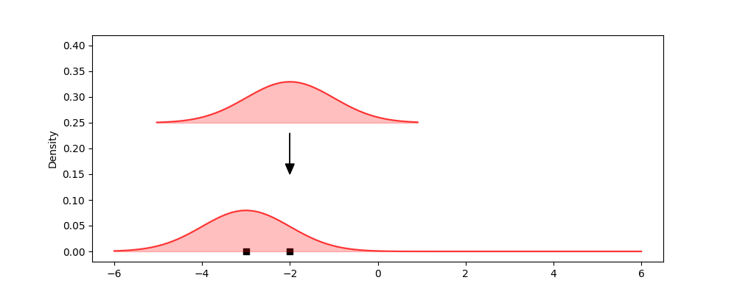
Density plot

Slide 43
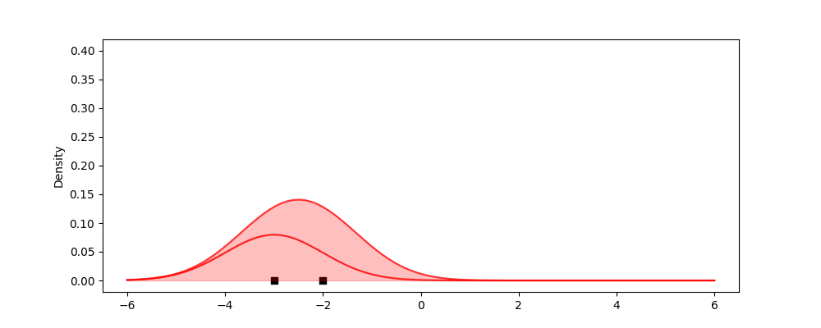
Density plot

Slide 44
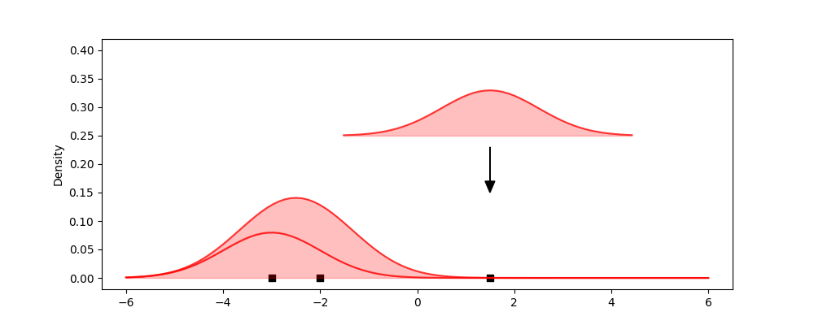
Density plot

Slide 45
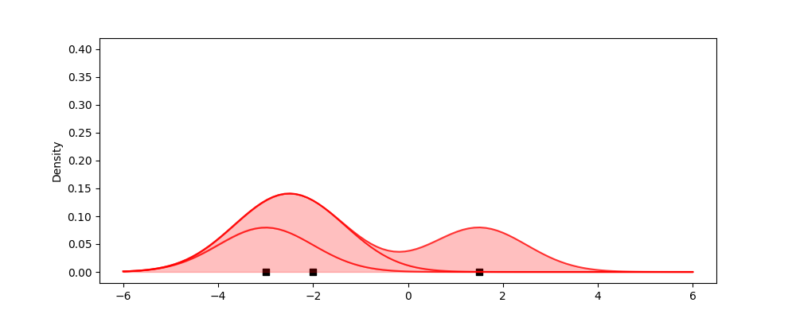
Density plot

Slide 46
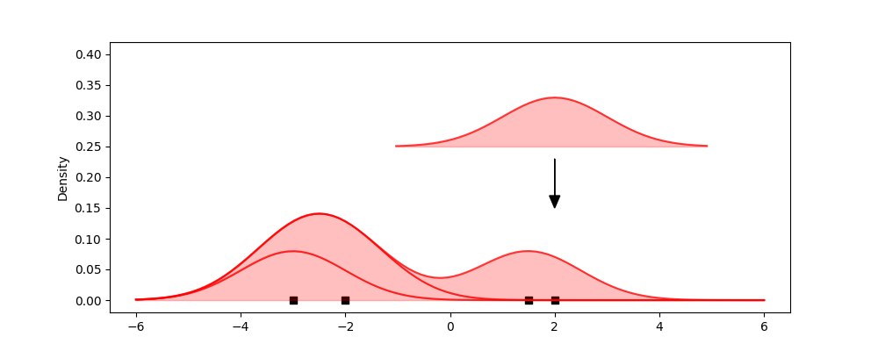
Density plot

Slide 47
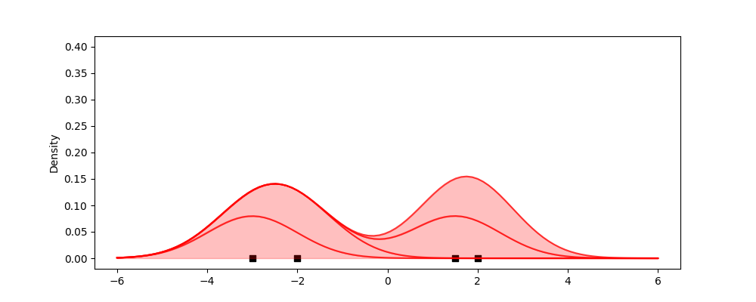
Density plot

Slide 48
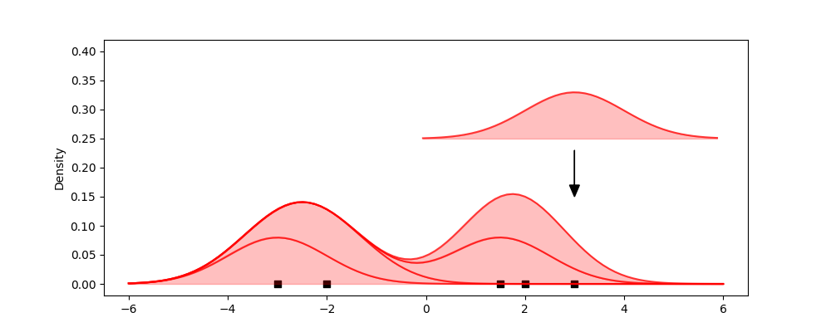
Density plot

Slide 49
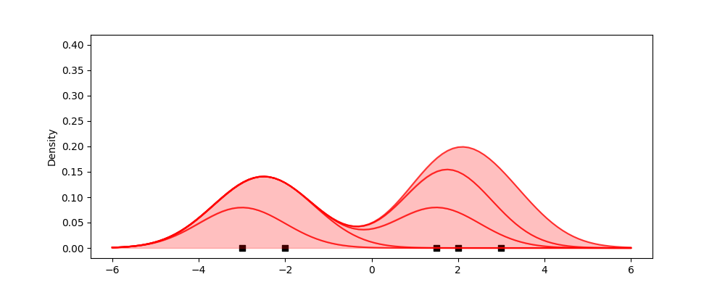
Density plot

Slide 50
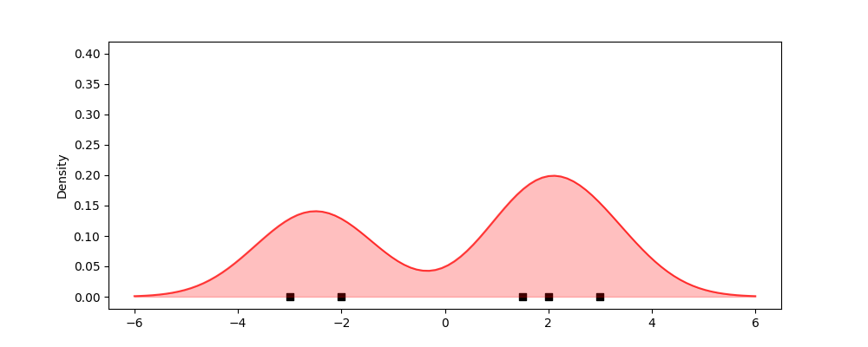
Density plot

Slide 51
Kernel Bandwidth

Slide 52
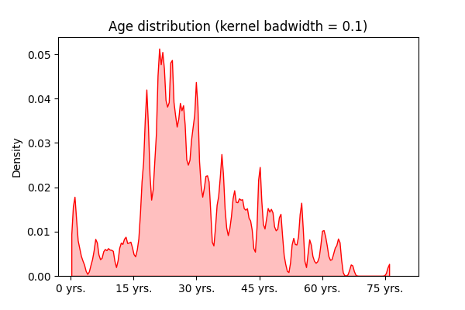
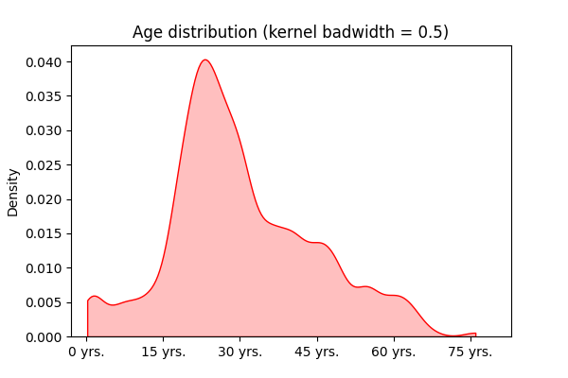
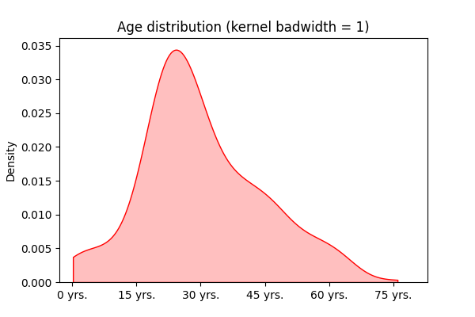
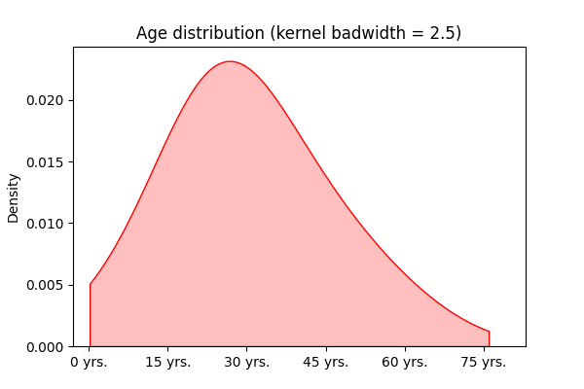

Slide 53
Comparing multiple distributions

Slide 54
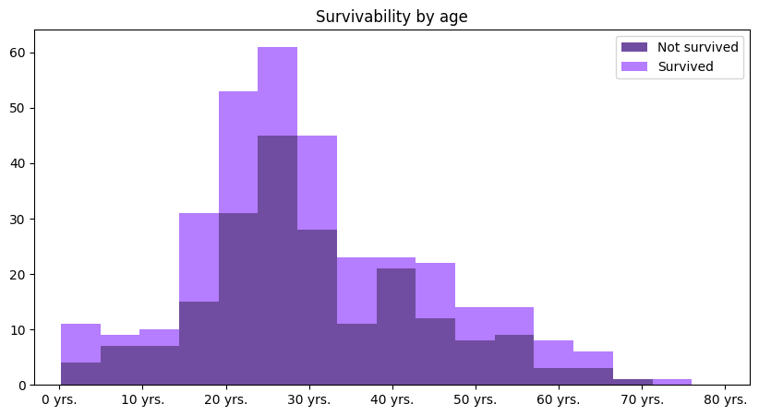
Stacked histogram

Slide 55
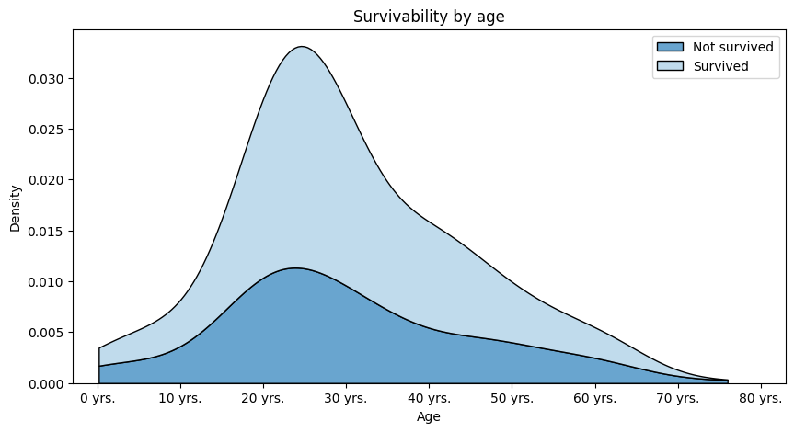
Stacked density plot

Slide 56
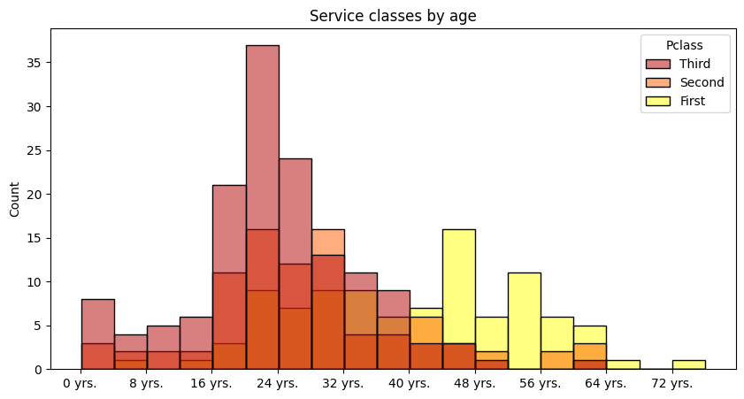
Overlapping density plot

Slide 57
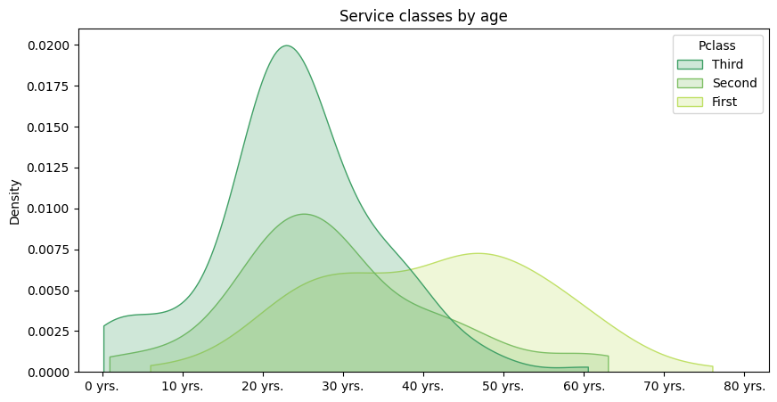
Overlapping density plot

Slide 58
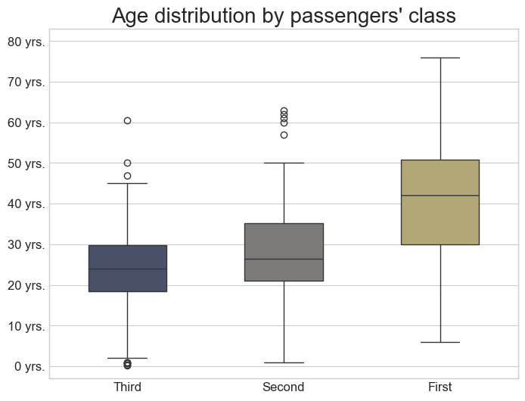
Box plots

Slide 59
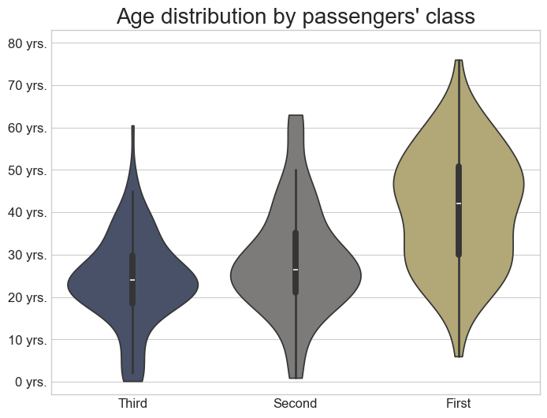
Violin plot

Slide 60
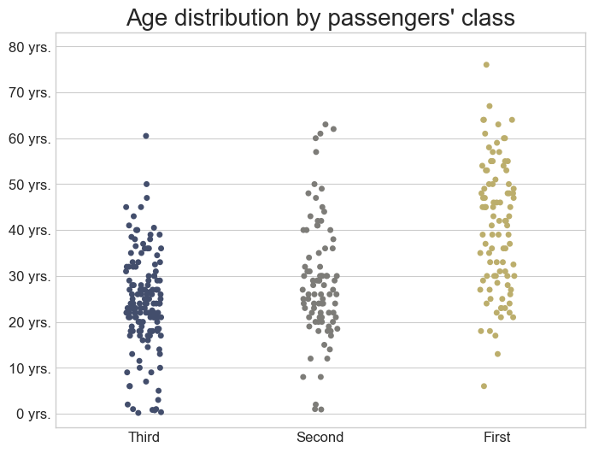
Strip plot

Slide 61
Logarithmic scale

Slide 62
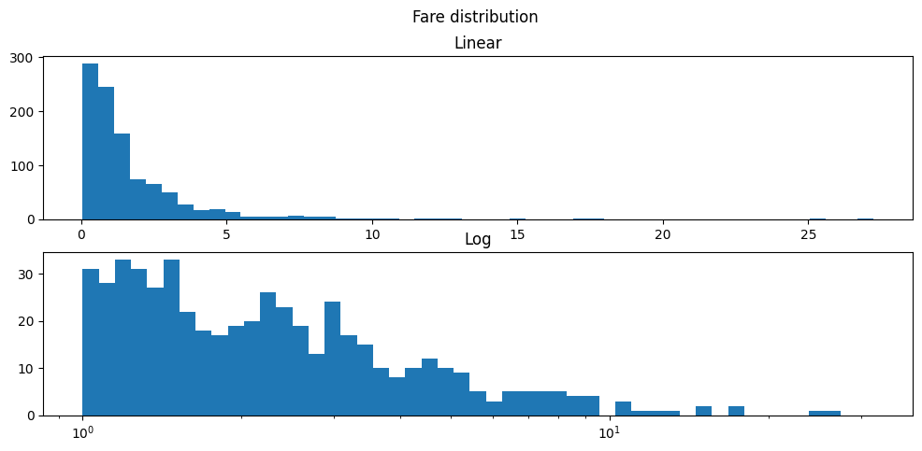
Logarithmic scale

Slide 63
Real vs theoretical distribution

Slide 64
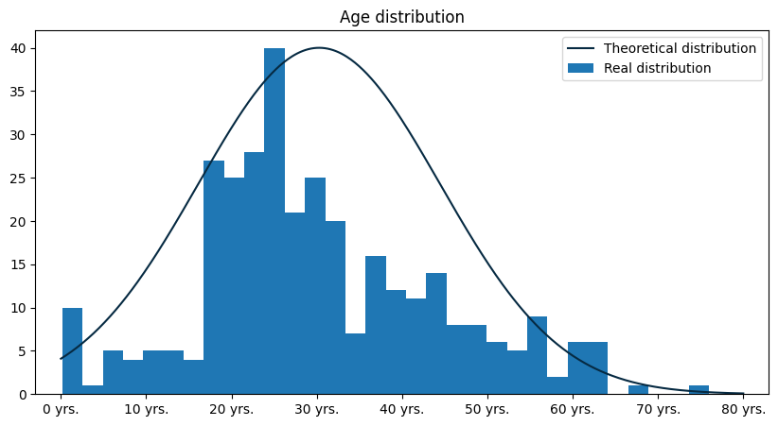
Real vs theoretical distribution

Slide 65
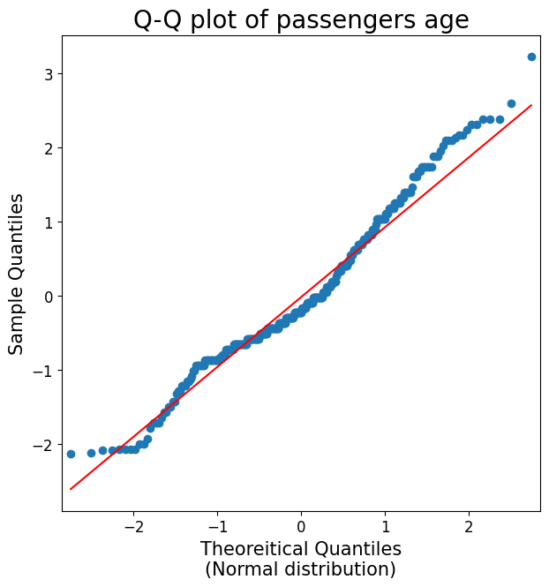
Real vs theoretical distribution

Slide 66
Frequently made mistakes

Slide 67
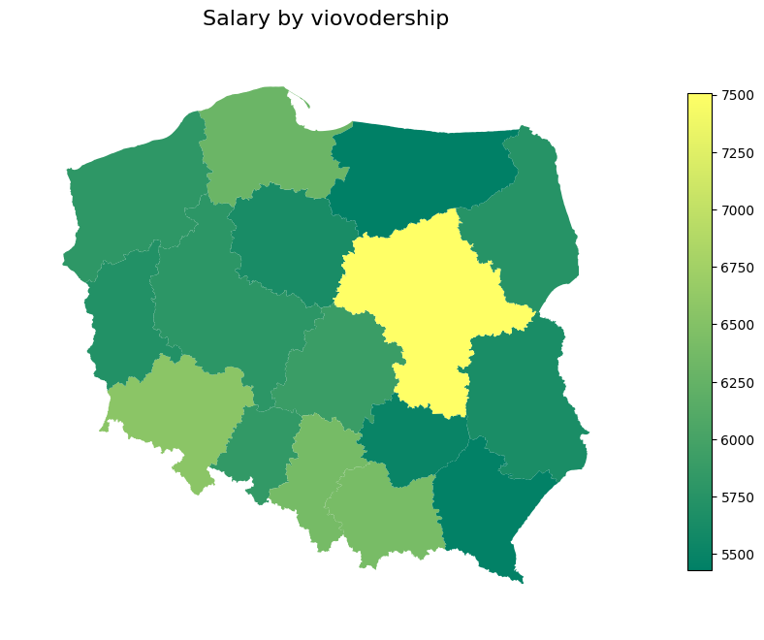
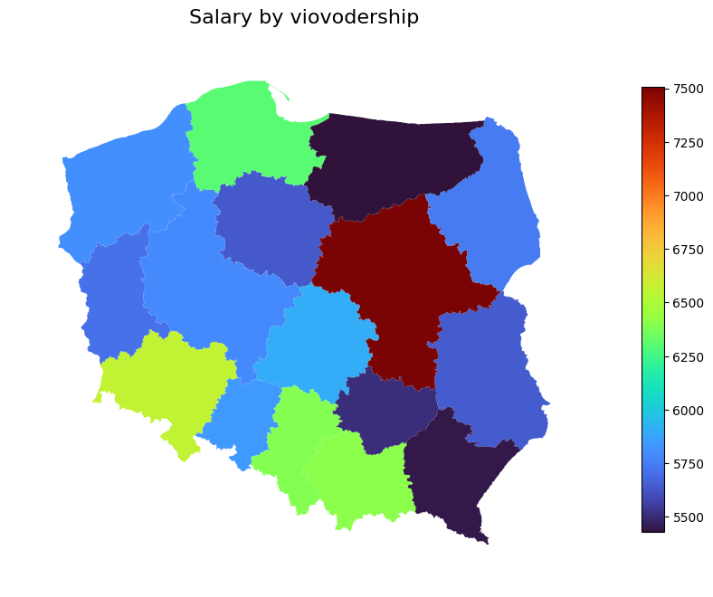
Incorrect color scale

Slide 68
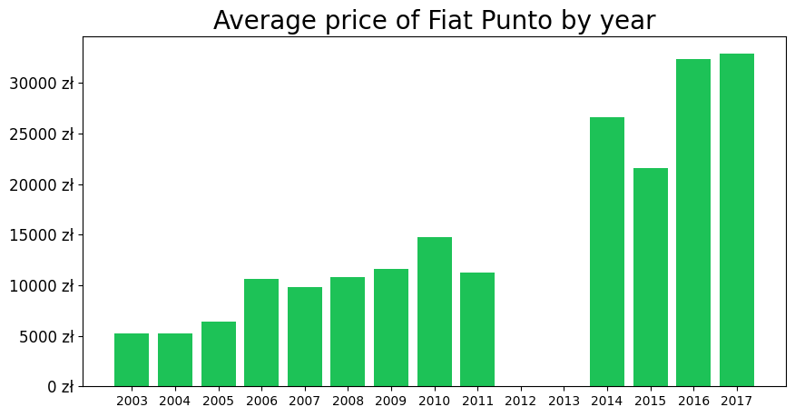
Informing about missing data

Slide 69
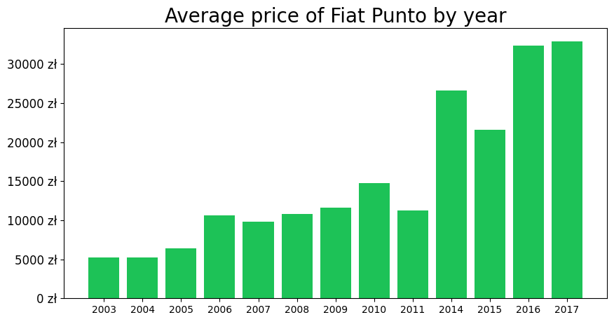
Informing about missing data

Slide 70
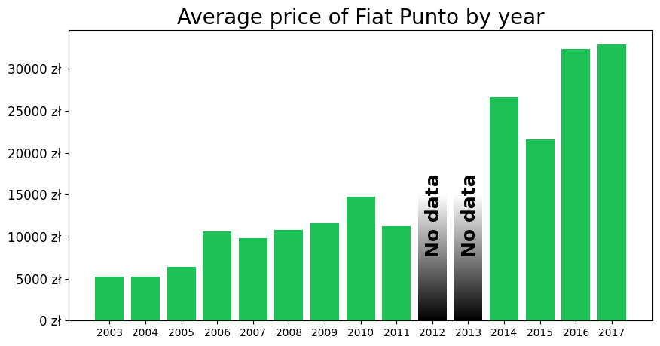
Informing about missing data

Slide 71

Manipulating scale

Slide 72

Manipulating scale

Slide 73

Manipulating scale

Slide 74

Manipulating scale

Slide 75

Manipulating scale

Slide 76

Too many informations

Slide 77

Too many informations

Slide 78
References
Information sources:
[1] Wes McKinney, Python for Data Analysis, 3E (2022), Wes’s Blog
[2] Claus O. Wilke, Fundamentals of Data Visualization (2019), Claus Website
[3] Jarosław Drapala, Kernel Density Estimator explained step by step (2023), Medium - Towards Data Science
[4] 3Blue1Brown (Grant Sanderson), Why π is in the normal distribution (beyond integral tricks) (2023), Youtube
[5] Reveal BI, The Importance of Data Visualizations (2020), Youtube
Data sources:
[5] Brenda N, Titanic dataset (2021), Kaggle
[6] Główny Urząd Statystyczny, Obwieszczenie w sprawie wysokości przeciętnego miesięcznego wynagrodzenia brutto w gospodarce narodowej w województwach w 2022 roku (2023), GUS
[7] Aleksandr Glotov, Car Prices Poland (2021), Kaggle
Other:
[8] My private notes about data visualization an examples
Presentation author: Maksymilian Norkiewicz

